Slide 1
Side-of-Body Separation
(Wing-Body Trailing-Edge Juncture Separation)

Slide 2
Side-of-Body Separation
10 Submitted (partial) Data Sets (as of June 21)
Grids
7 Unstructured
1 Overset
1 Multi-block
1 Custom Cartesian
Turbulence Models
2 SA
6 SA QCR
1 SST
1 k-ε

Slide 3
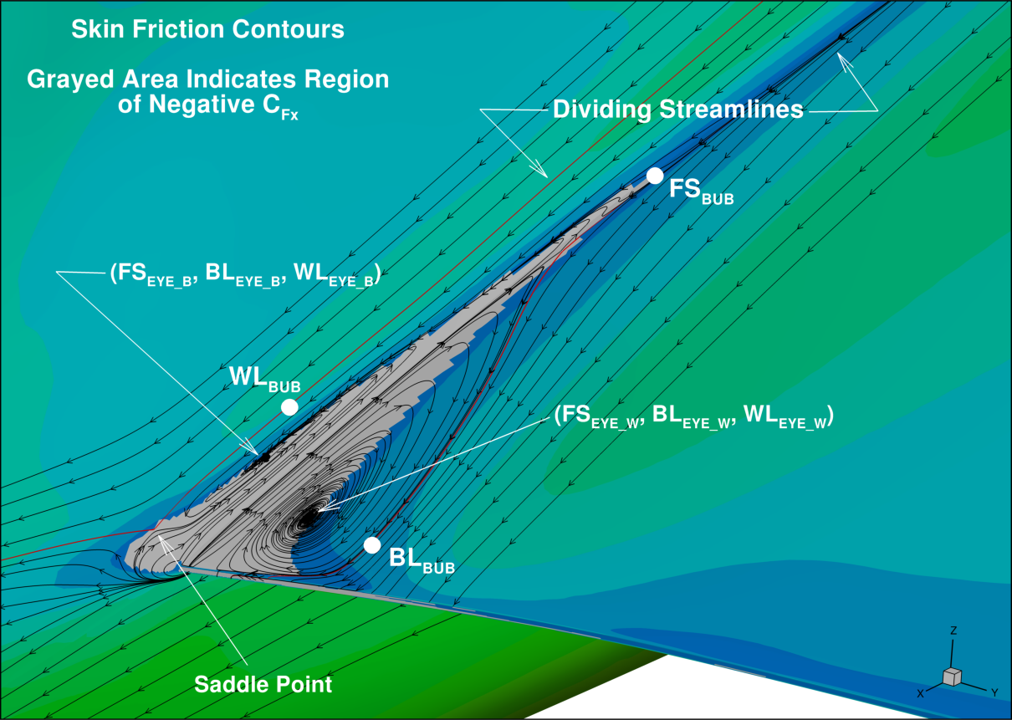
Separation Bubble

Slide 4
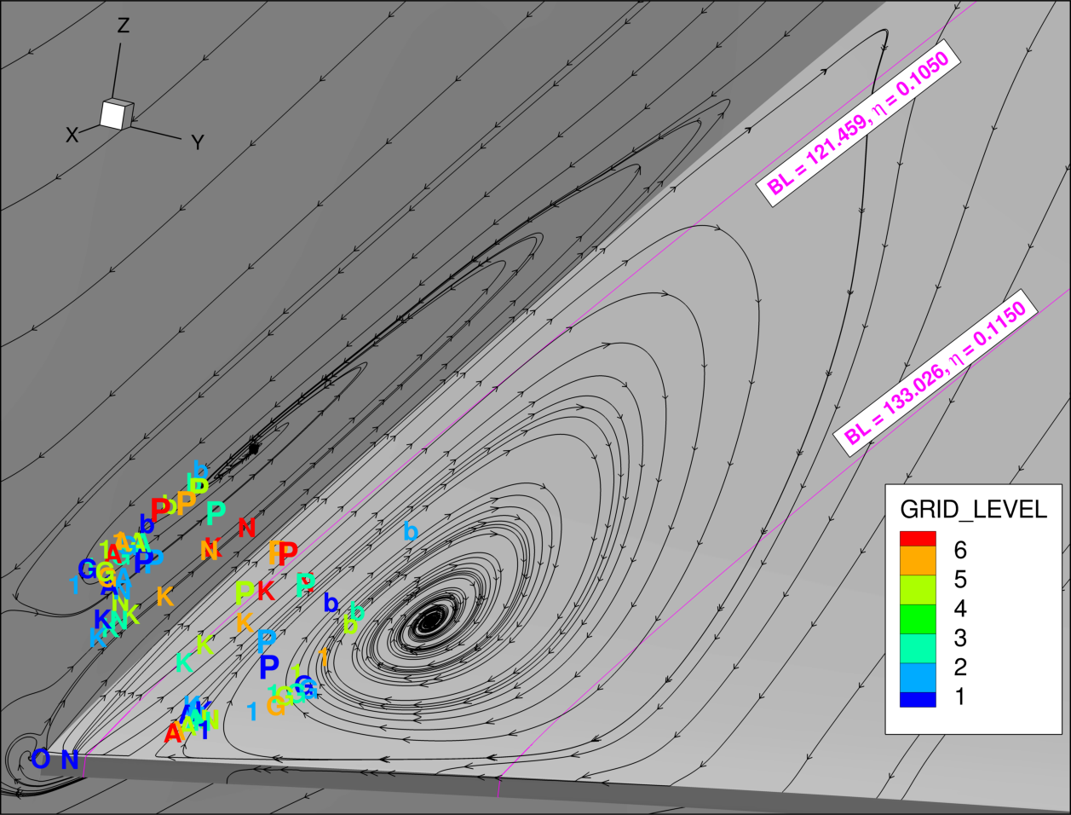
CASE 1A: Grid Refinement – Eye Locations

Slide 5
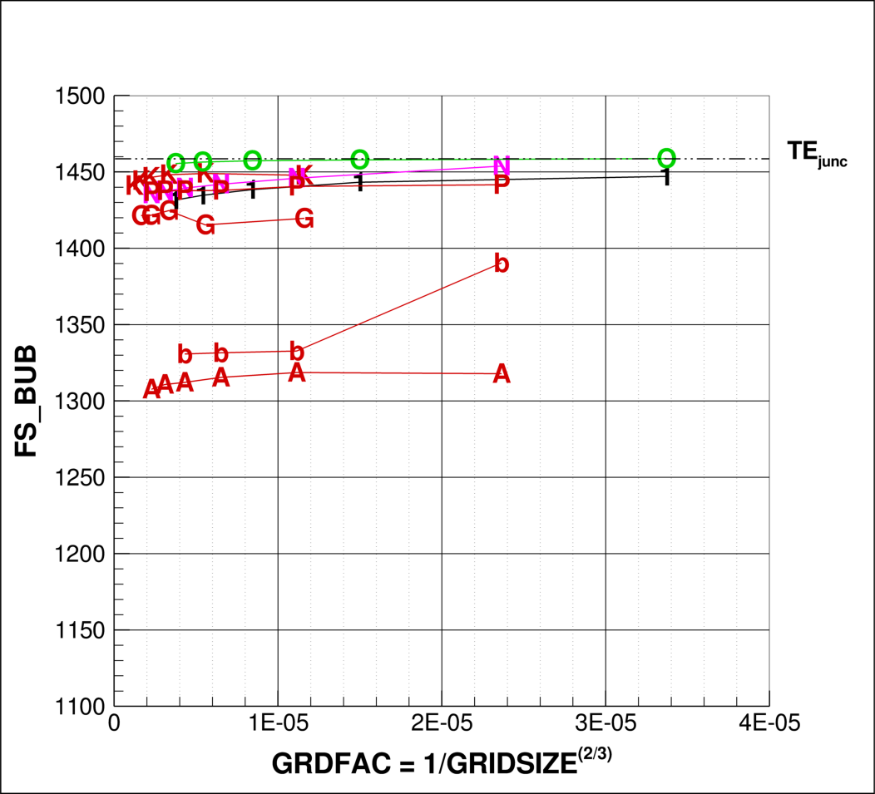
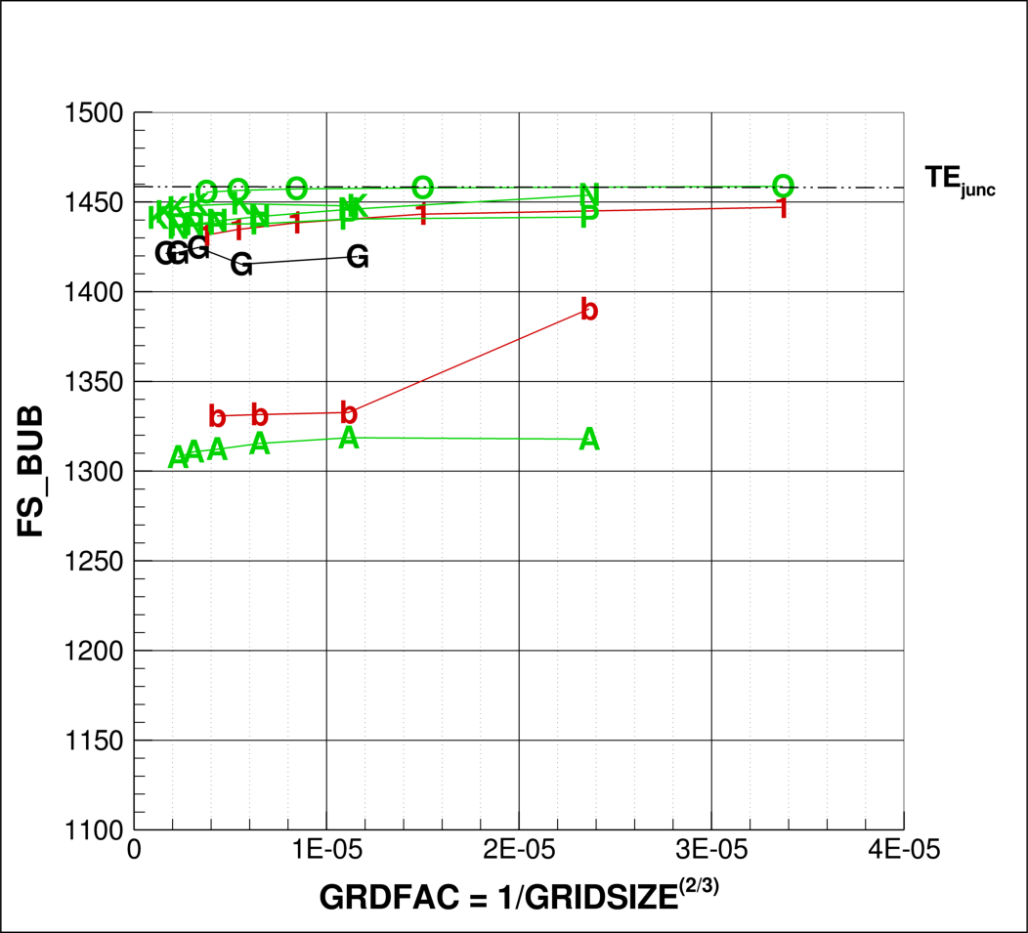
CASE 1A: Grid Refinement
Bubble Leading Edge
Grid Type
Unstructured
Multi-block
Overset
Custom Cart
Turbulence Model
SA
SA QRC
SST
k-ε

Slide 6
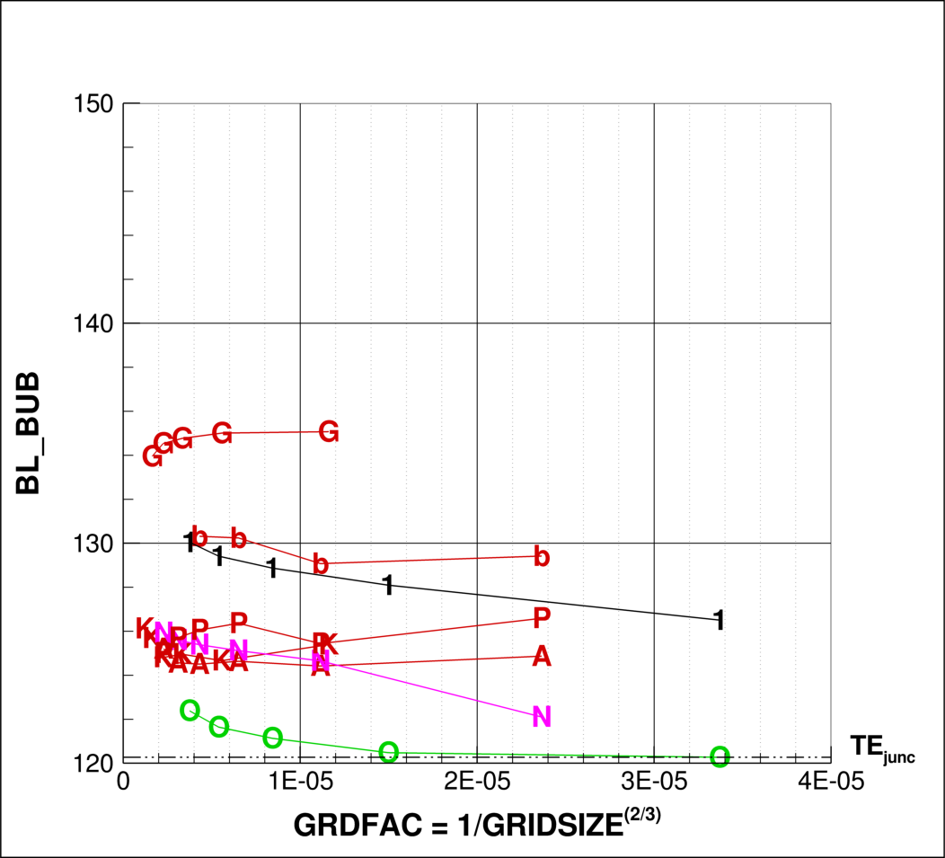
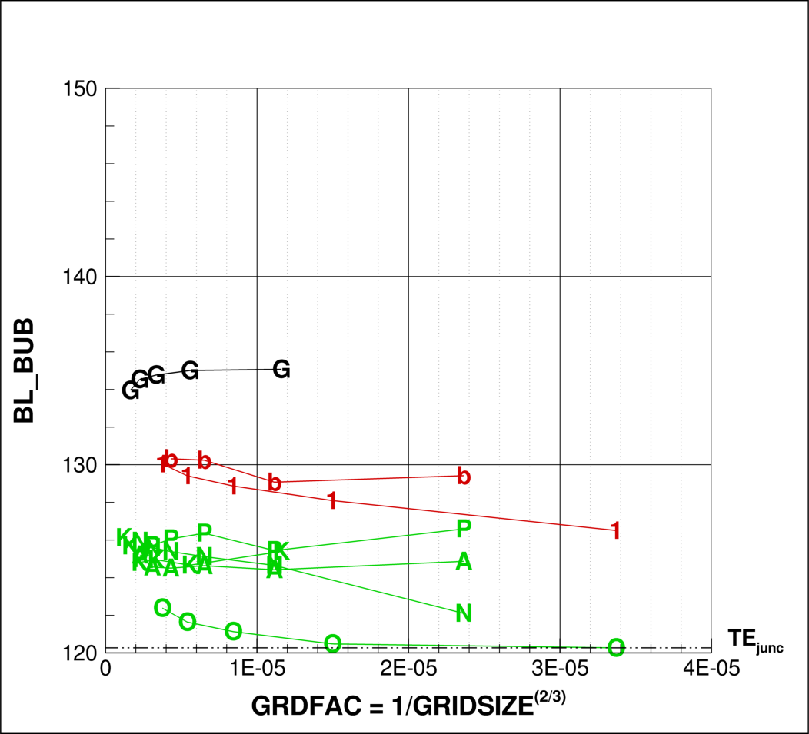
CASE 1A: Grid Refinement
Bubble Width (wing)
Grid Type
Unstructured
Multi-block
Overset
Custom Cart
Turbulence Model
SA
SA QRC
SST
k-ε

Slide 7
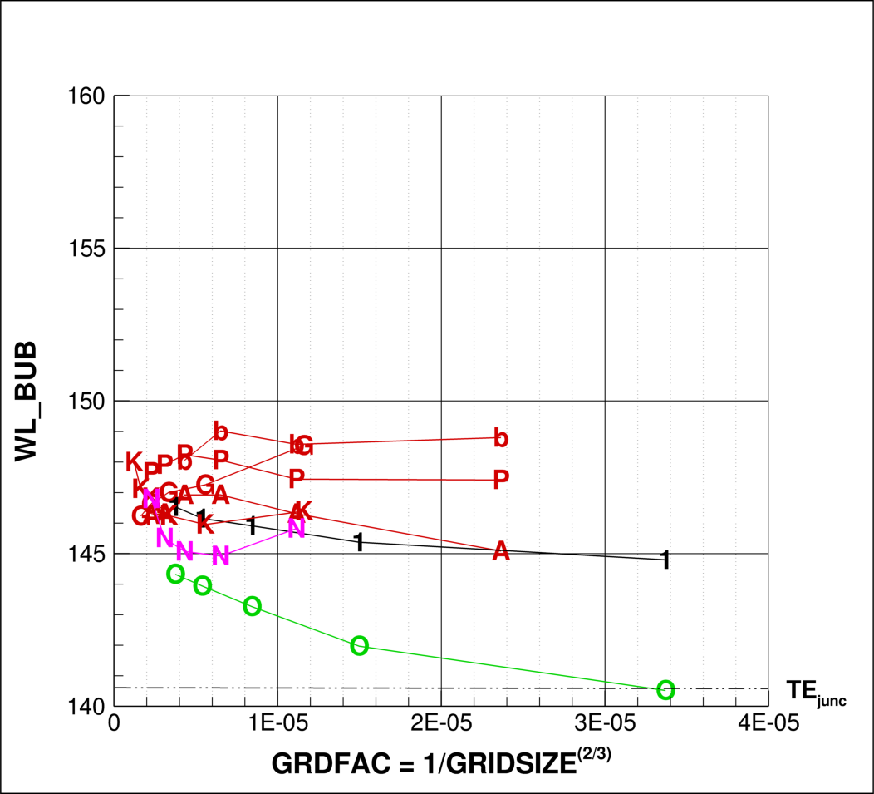
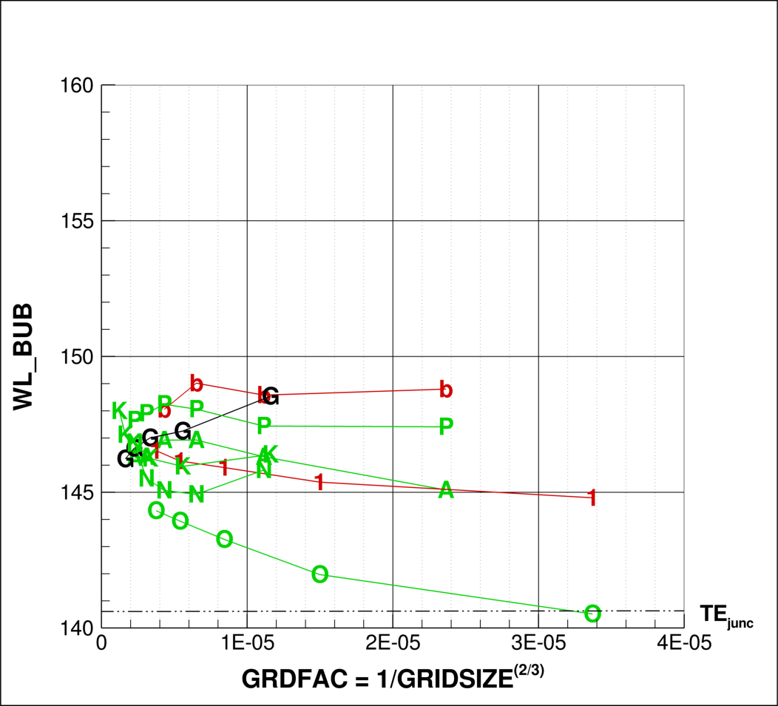
CASE 1A: Grid Refinement
Bubble Height (fuselage)
Grid Type
Unstructured
Multi-block
Overset
Custom Cart
Turbulence Model
SA
SA QRC
SST
k-ε

Slide 8
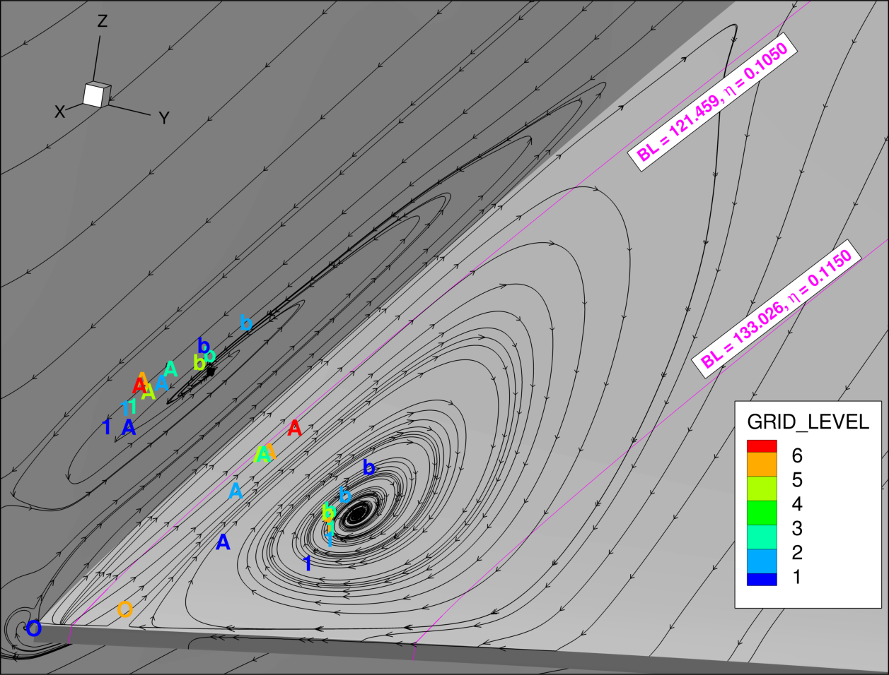
CASE 1B: Grid Refinement – Eye Locations

Slide 9
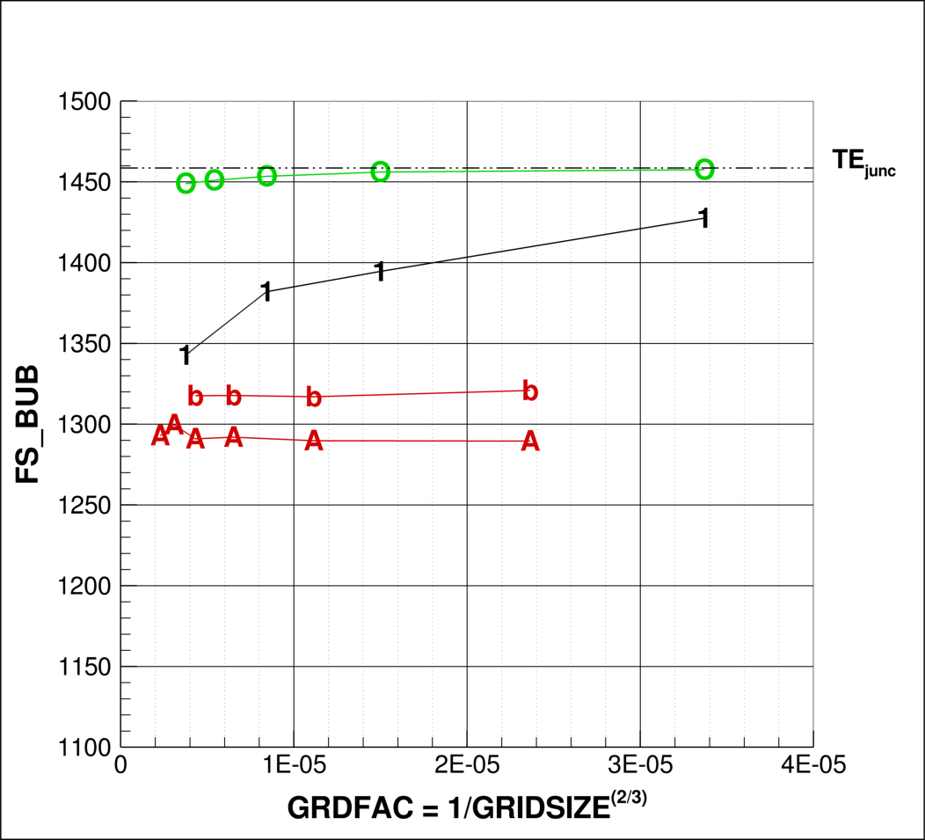
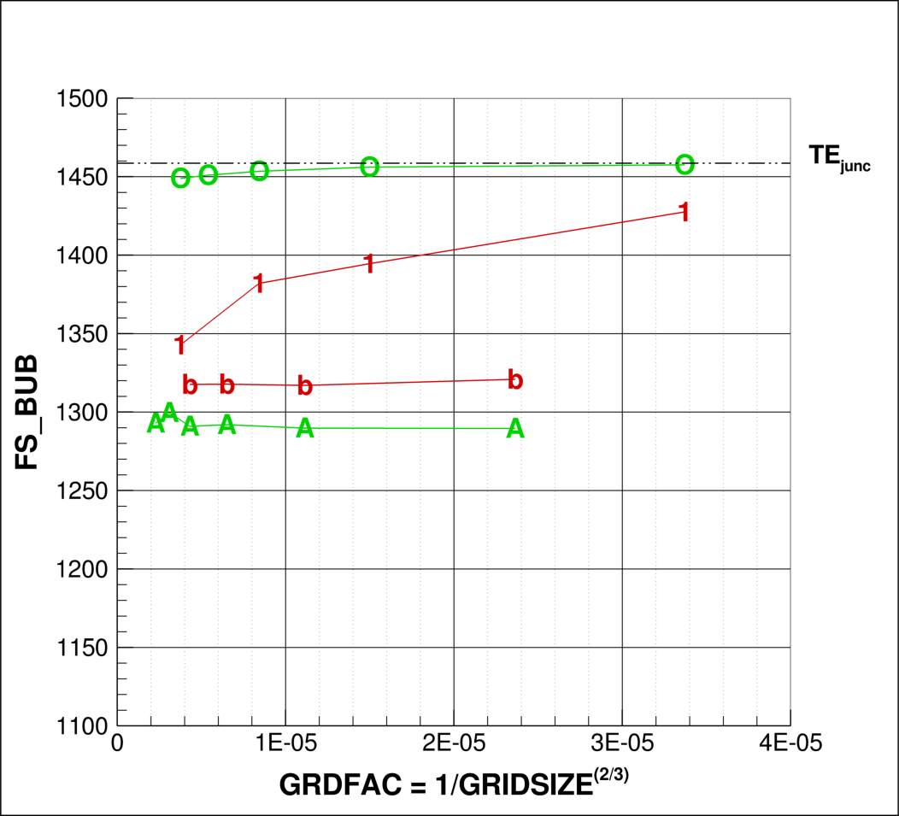
CASE 1B: Grid Refinement
Bubble Leading Edge
Grid Type
Unstructured
Multi-block
Overset
Custom Cart
Turbulence Model
SA
SA QRC
SST
k-ε

Slide 10
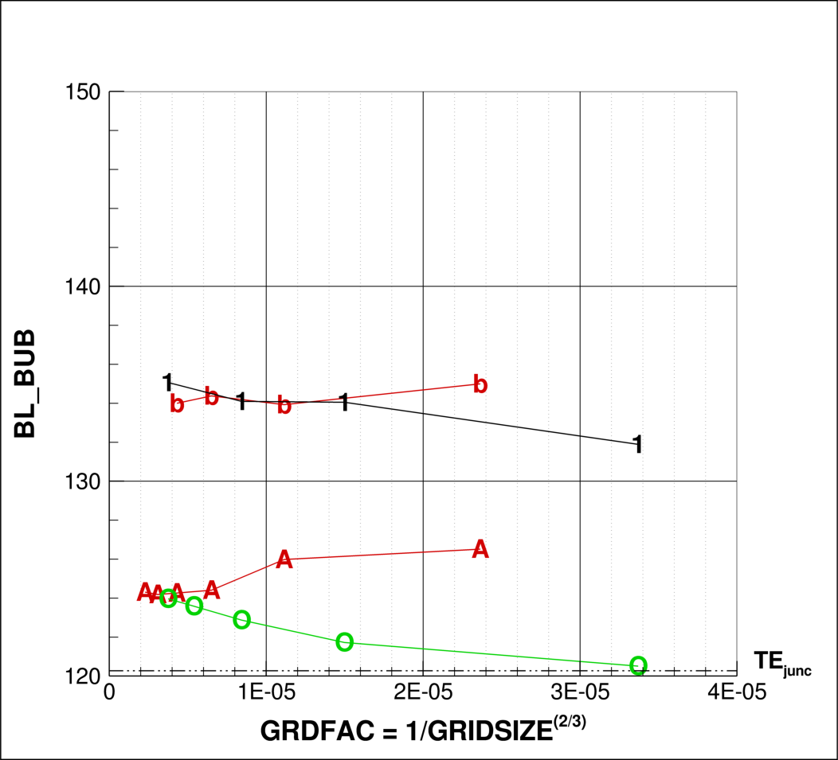
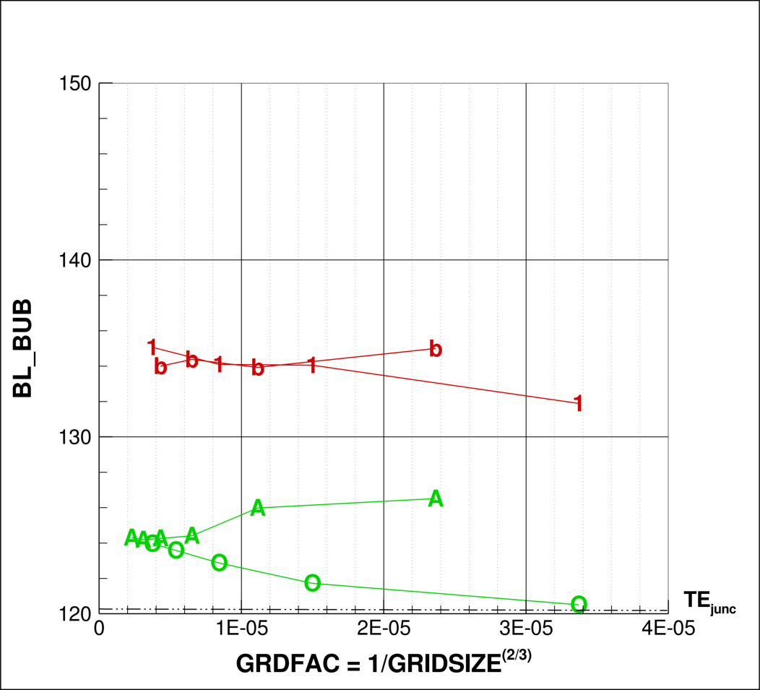
CASE 1B: Grid Refinement
Bubble Width (wing)
Grid Type
Unstructured
Multi-block
Overset
Custom Cart
Turbulence Model
SA
SA QRC
SST
k-ε

Slide 11
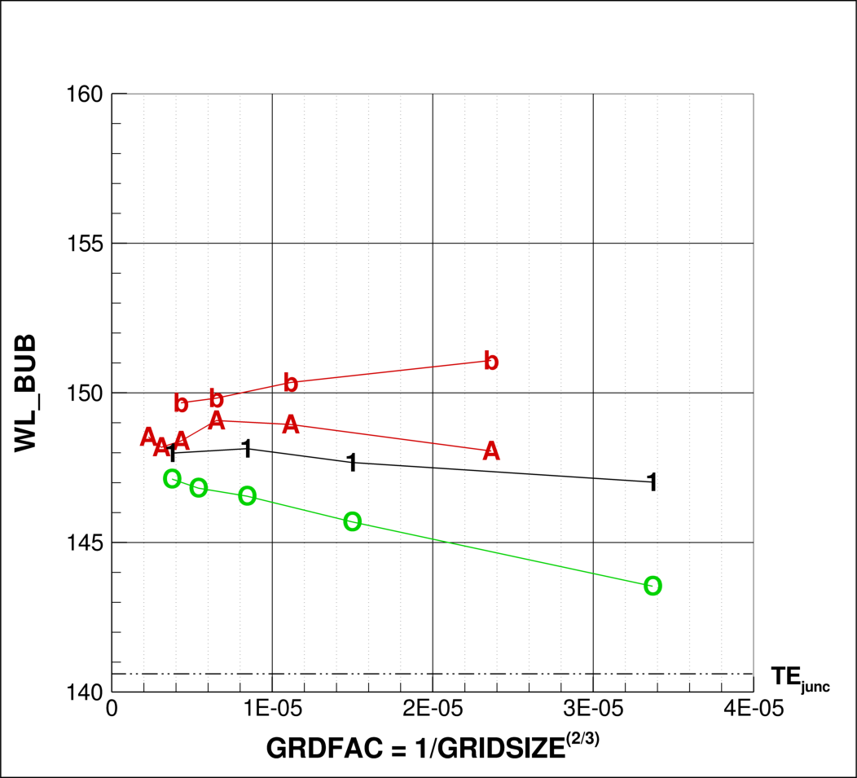
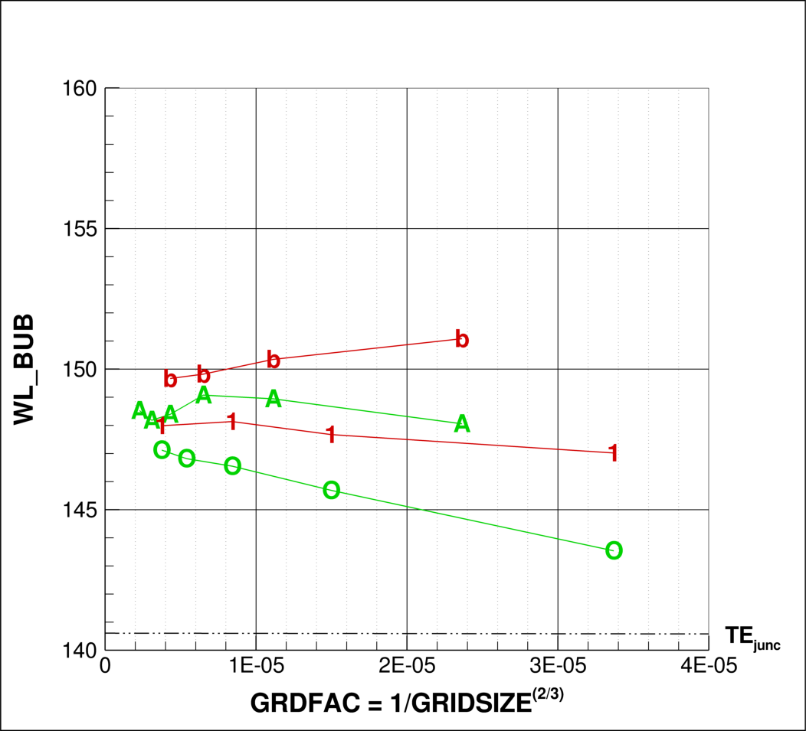
CASE 1B: Grid Refinement
Bubble Height (fuselage)
Grid Type
Unstructured
Multi-block
Overset
Custom Cart
Turbulence Model
SA
SA QRC
SST
k-ε

Slide 12
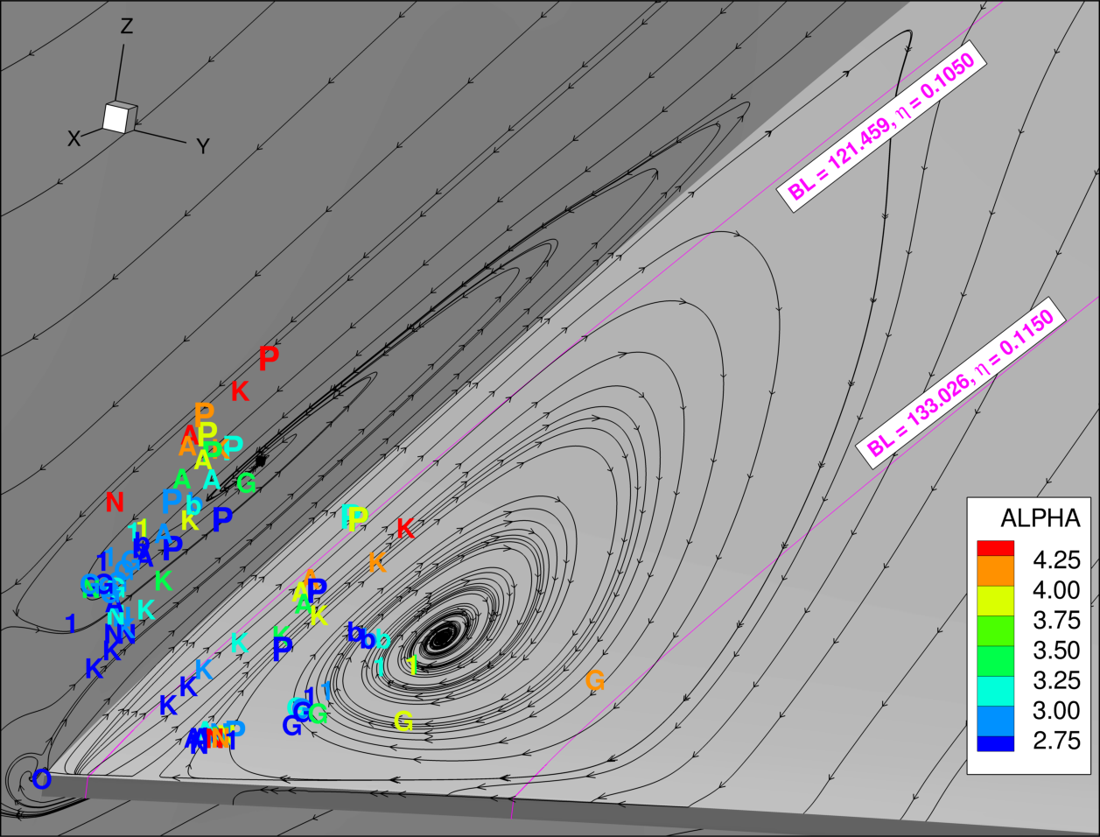
CASE 2A: Alpha Sweep – Eye Locations

Slide 13
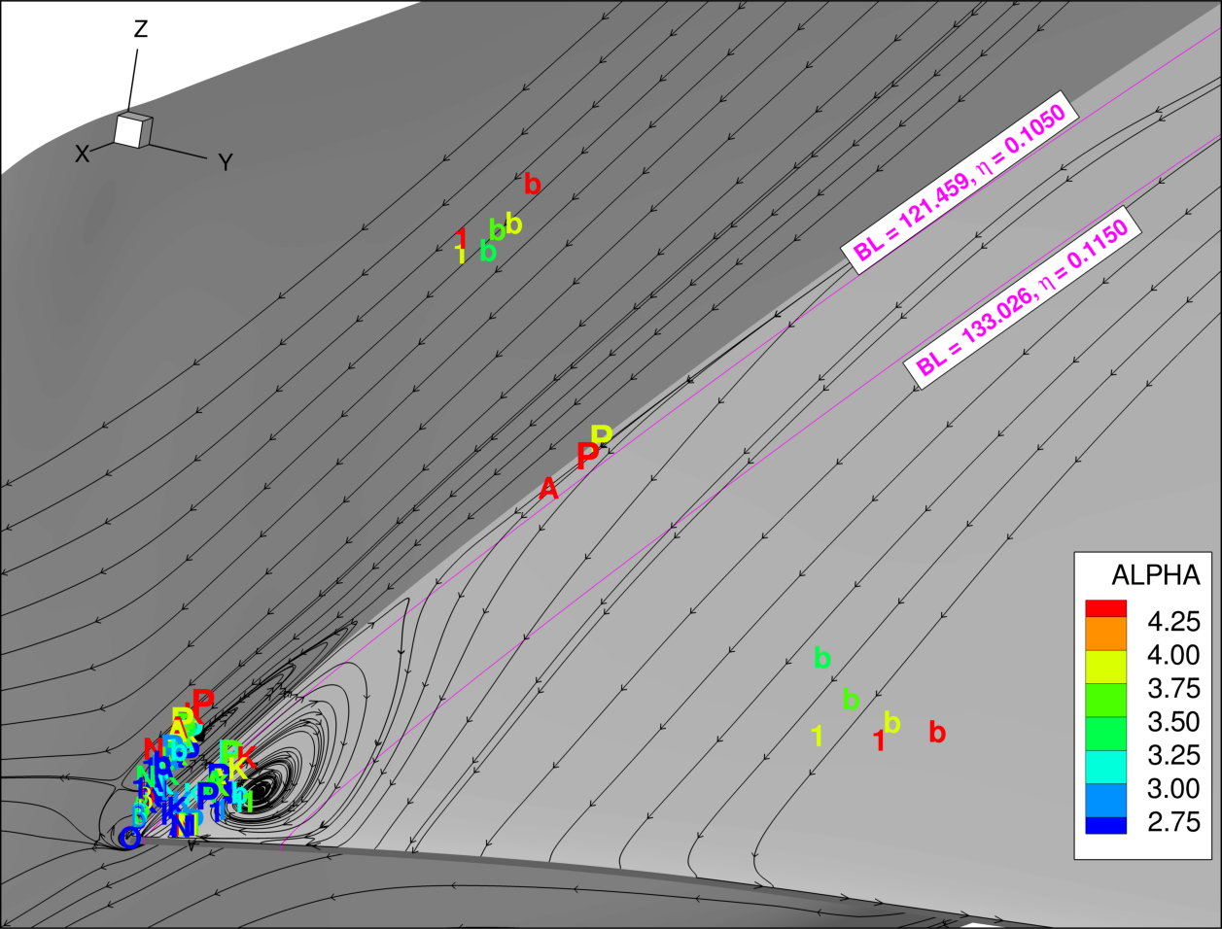
CASE 2A: Alpha Sweep – Eye Locations

Slide 14
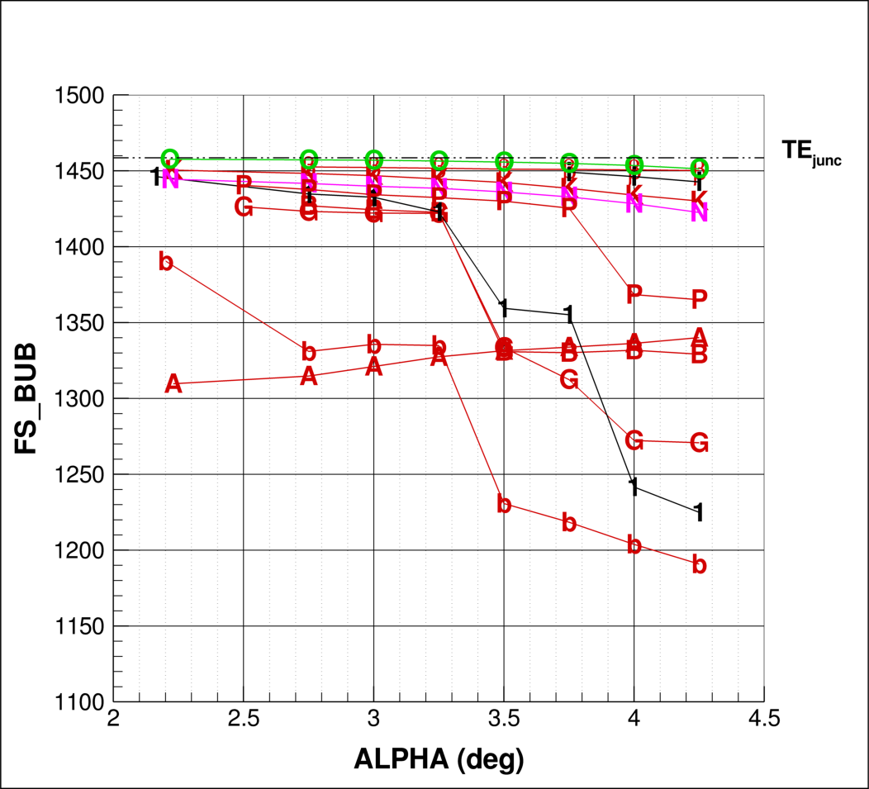
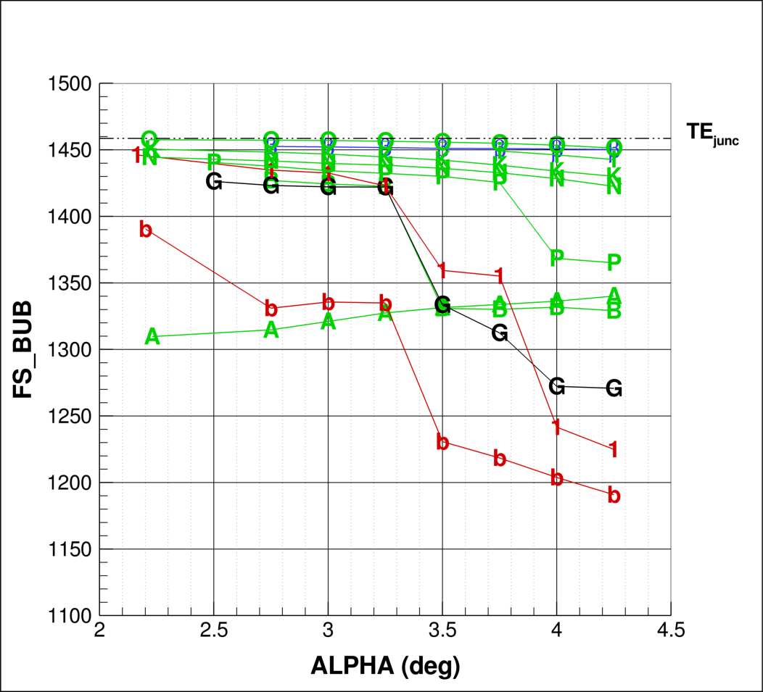
CASE 2A: Alpha Sweep
Bubble Leading Edge
Grid Type
Unstructured
Multi-block
Overset
Custom Cart
Turbulence Model
SA
SA QRC
SST
k-ε

Slide 15
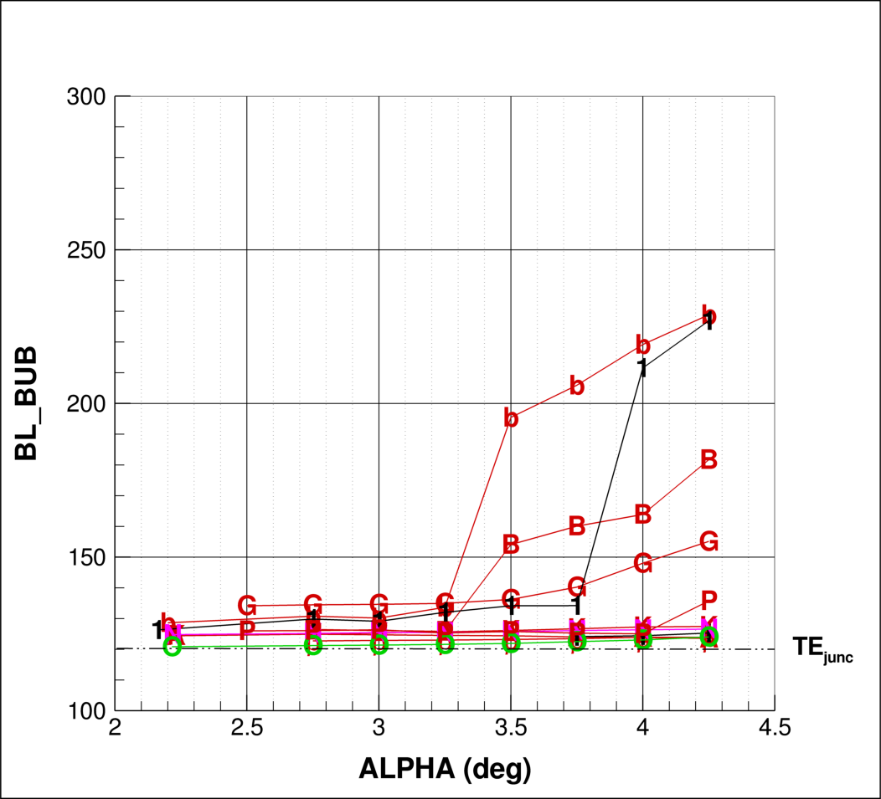
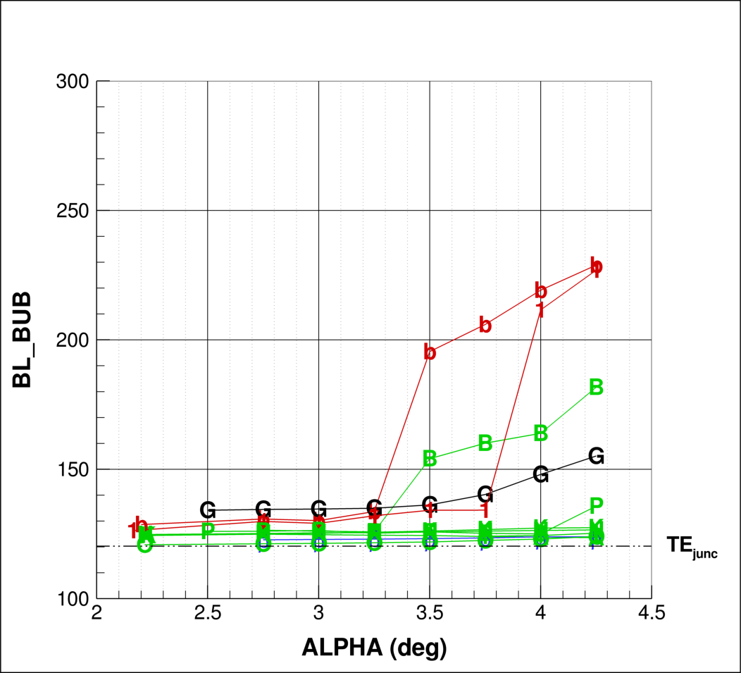
CASE 2A: Alpha Sweep
Bubble Width (wing)
Grid Type
Unstructured
Multi-block
Overset
Custom Cart
Turbulence Model
SA
SA QRC
SST
k-ε

Slide 16
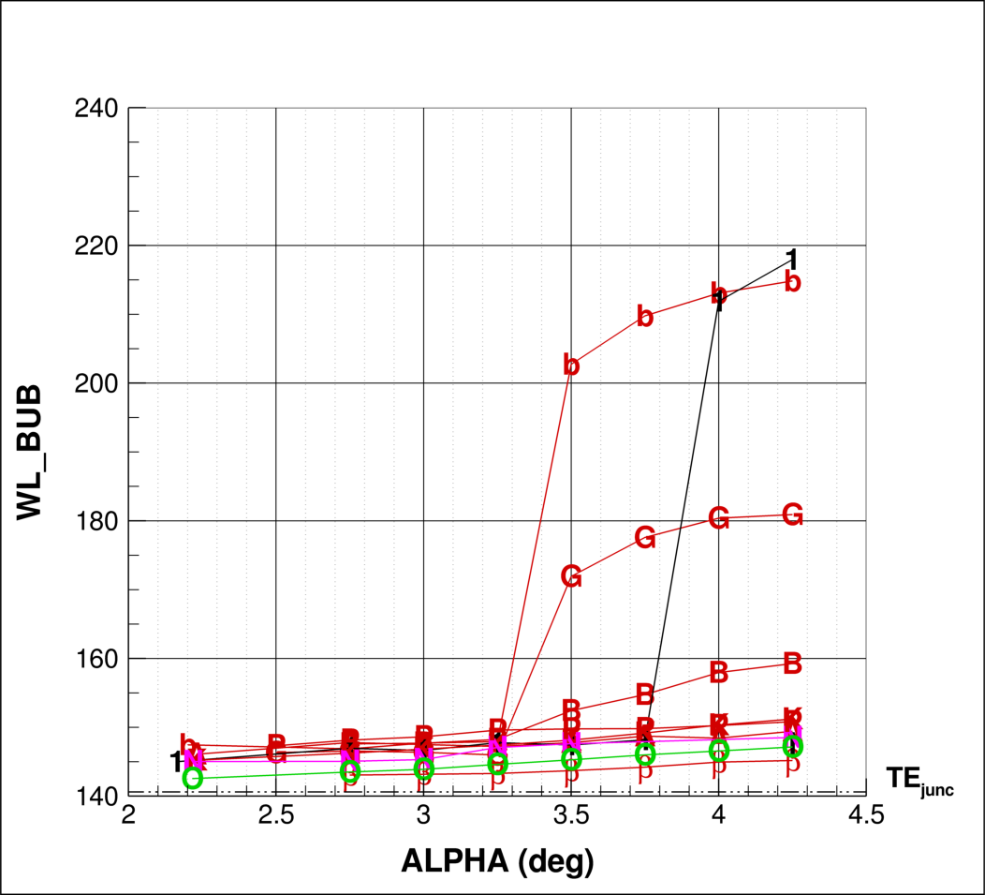
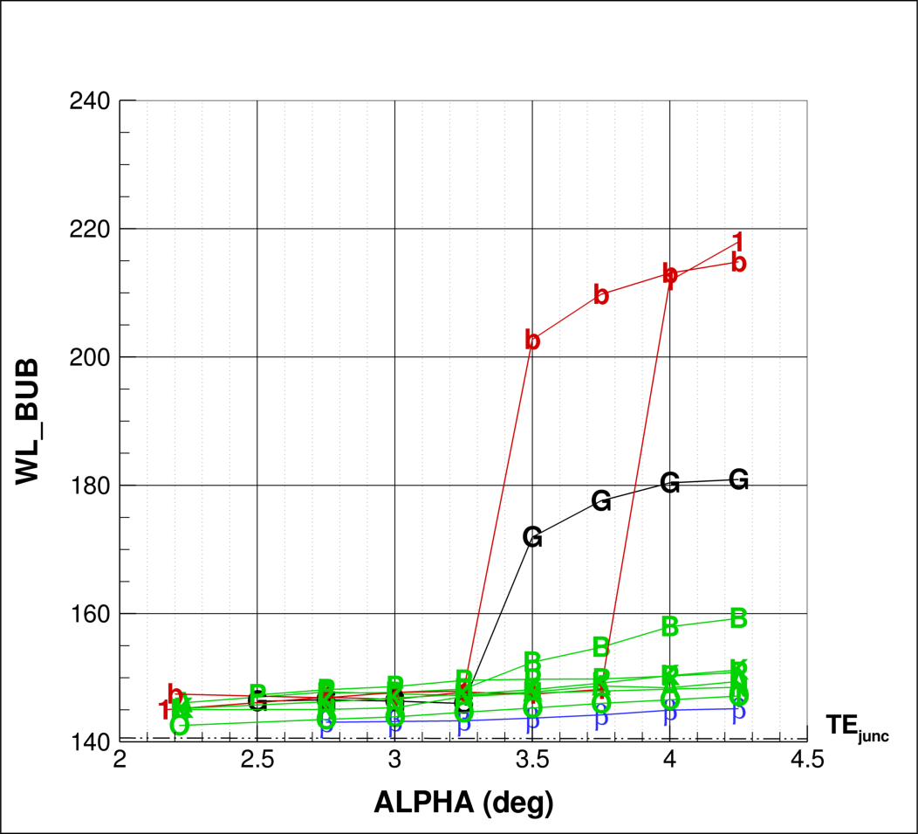
CASE 2A: Alpha Sweep
Bubble Height (fuselage)
Grid Type
Unstructured
Multi-block
Overset
Custom Cart
Turbulence Model
SA
SA QRC
SST
k-ε

Slide 17
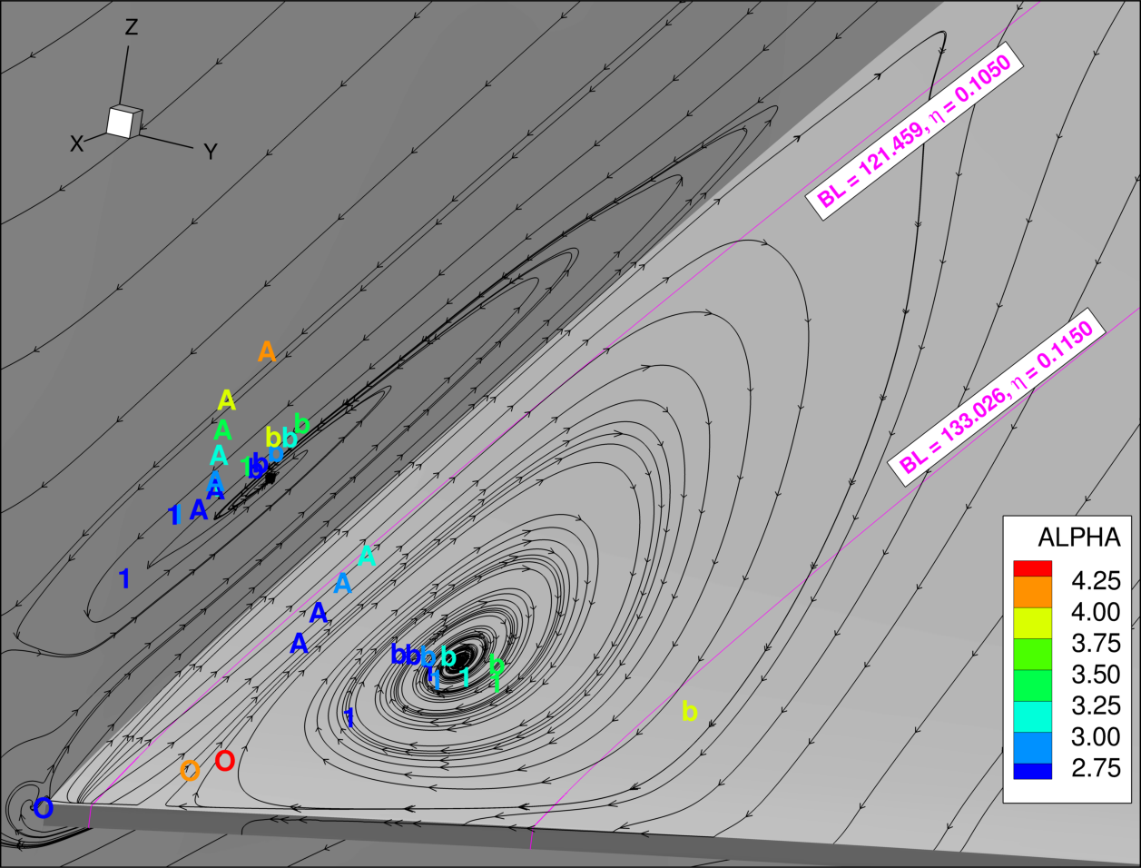
CASE 2B: Alpha Sweep – Eye Locations

Slide 18
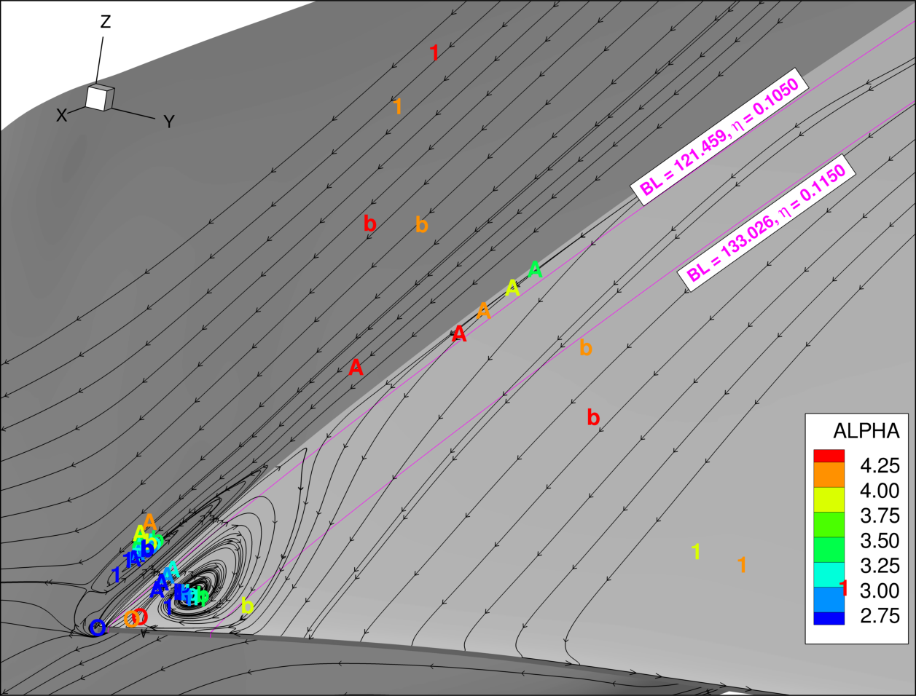
CASE 2B: Alpha Sweep – Eye Locations

Slide 19
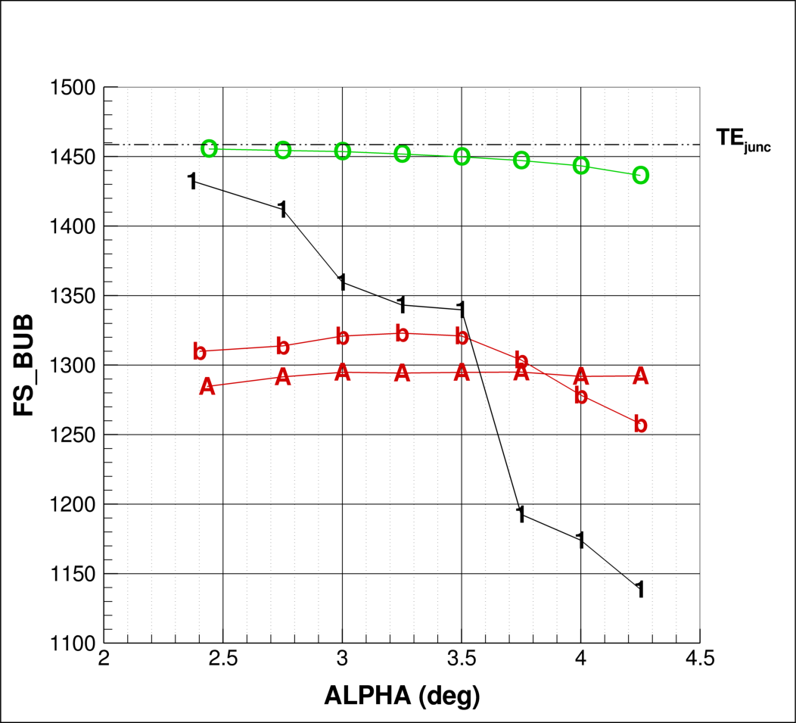
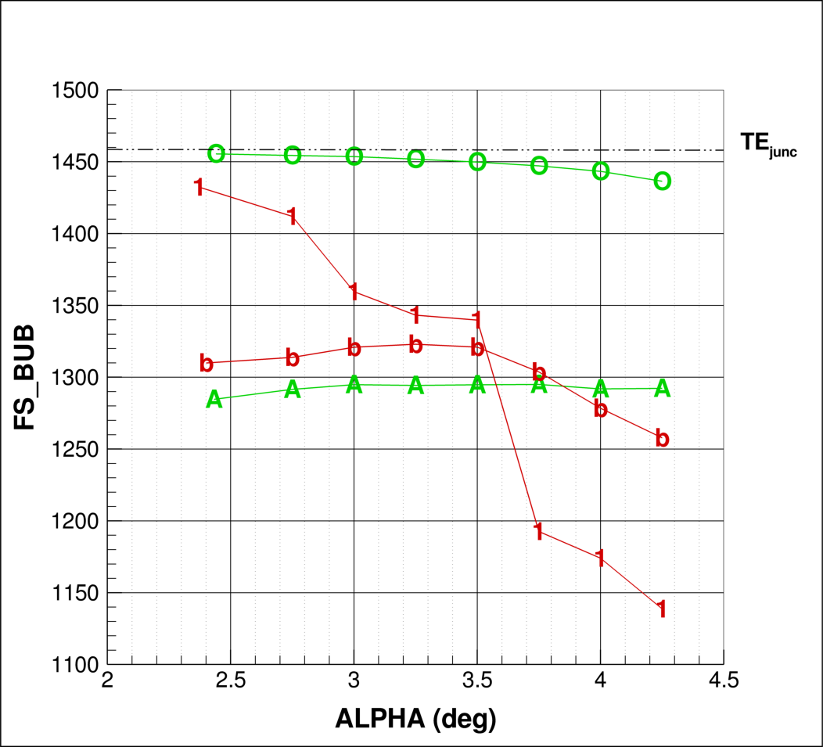
CASE 2B: Alpha Sweep
Bubble Leading Edge
Grid Type
Unstructured
Multi-block
Overset
Custom Cart
Turbulence Model
SA
SA QRC
SST
k-ε

Slide 20
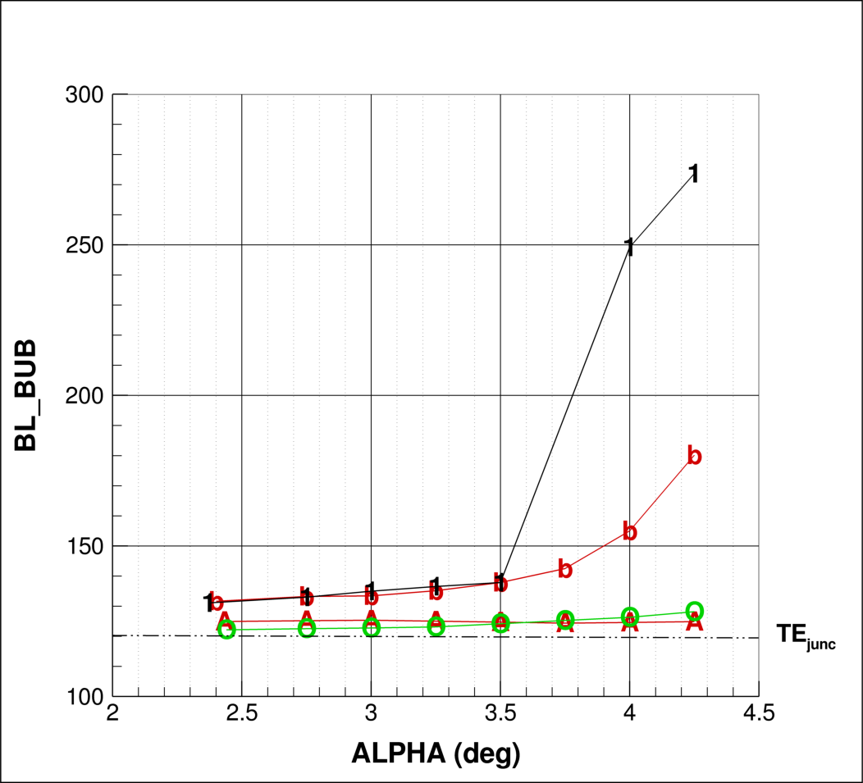
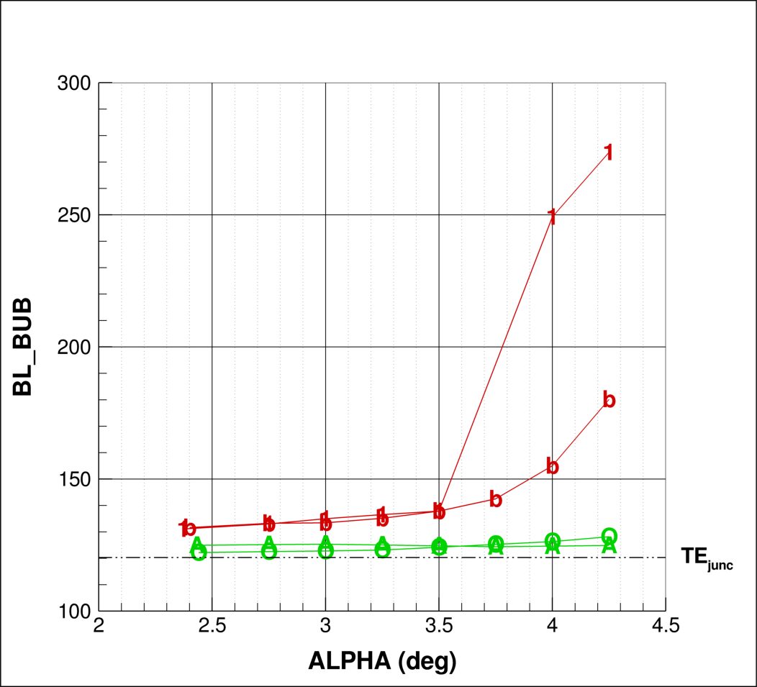
CASE 2B: Alpha Sweep
Bubble Width (wing)
Grid Type
Unstructured
Multi-block
Overset
Custom Cart
Turbulence Model
SA
SA QRC
SST
k-ε

Slide 21
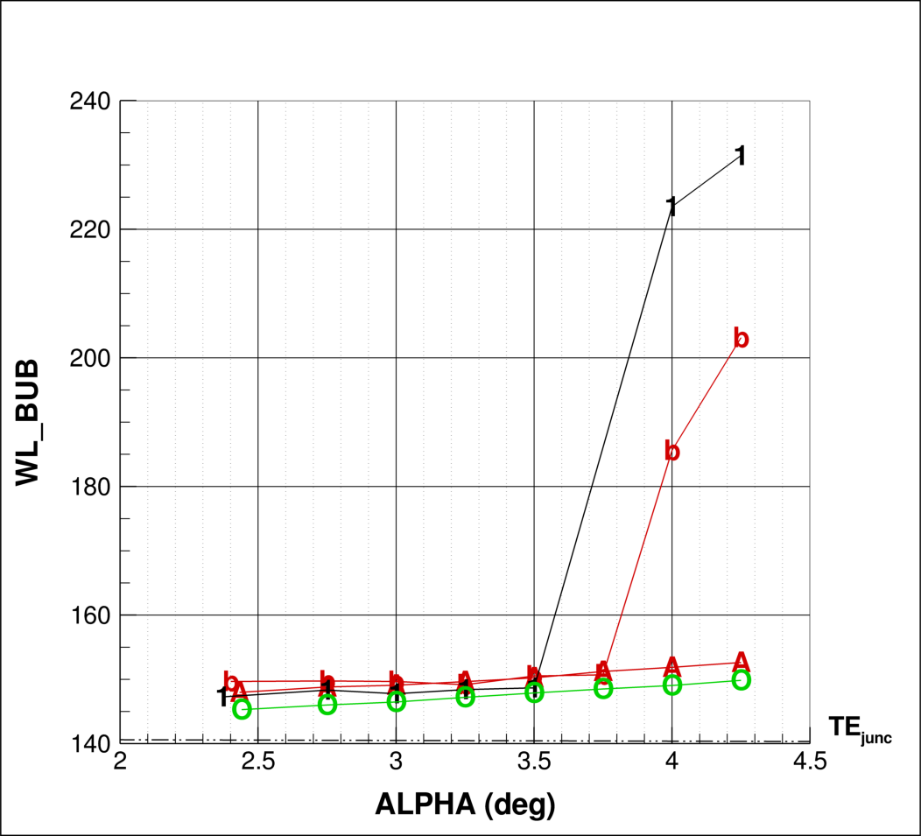
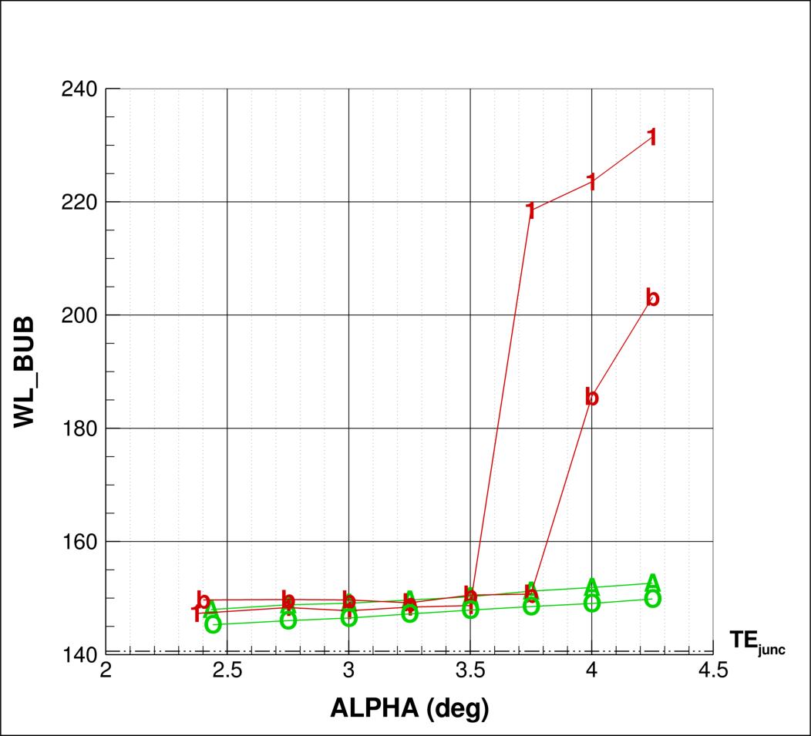
CASE 2B: Alpha Sweep
Bubble Height (fuselage)
Grid Type
Unstructured
Multi-block
Overset
Custom Cart
Turbulence Model
SA
SA QRC
SST
k-ε

Slide 22
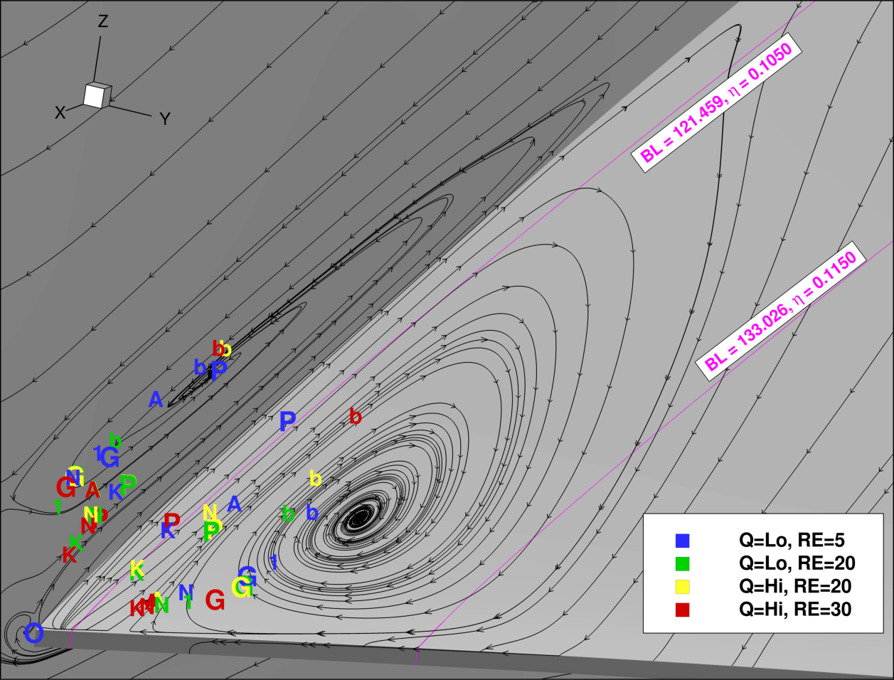
CASE 3: RN Sweep – Eye Locations

Slide 23
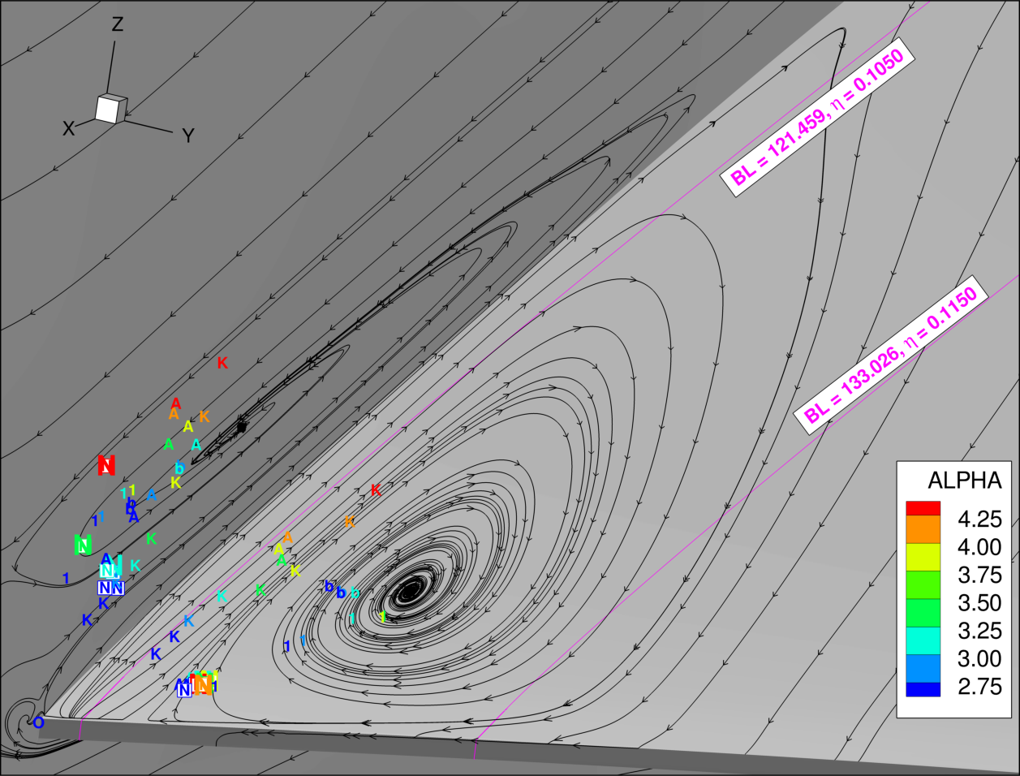
CASE 4: Alpha Sweep – Eye Locations: Adaptive Grid

Slide 24
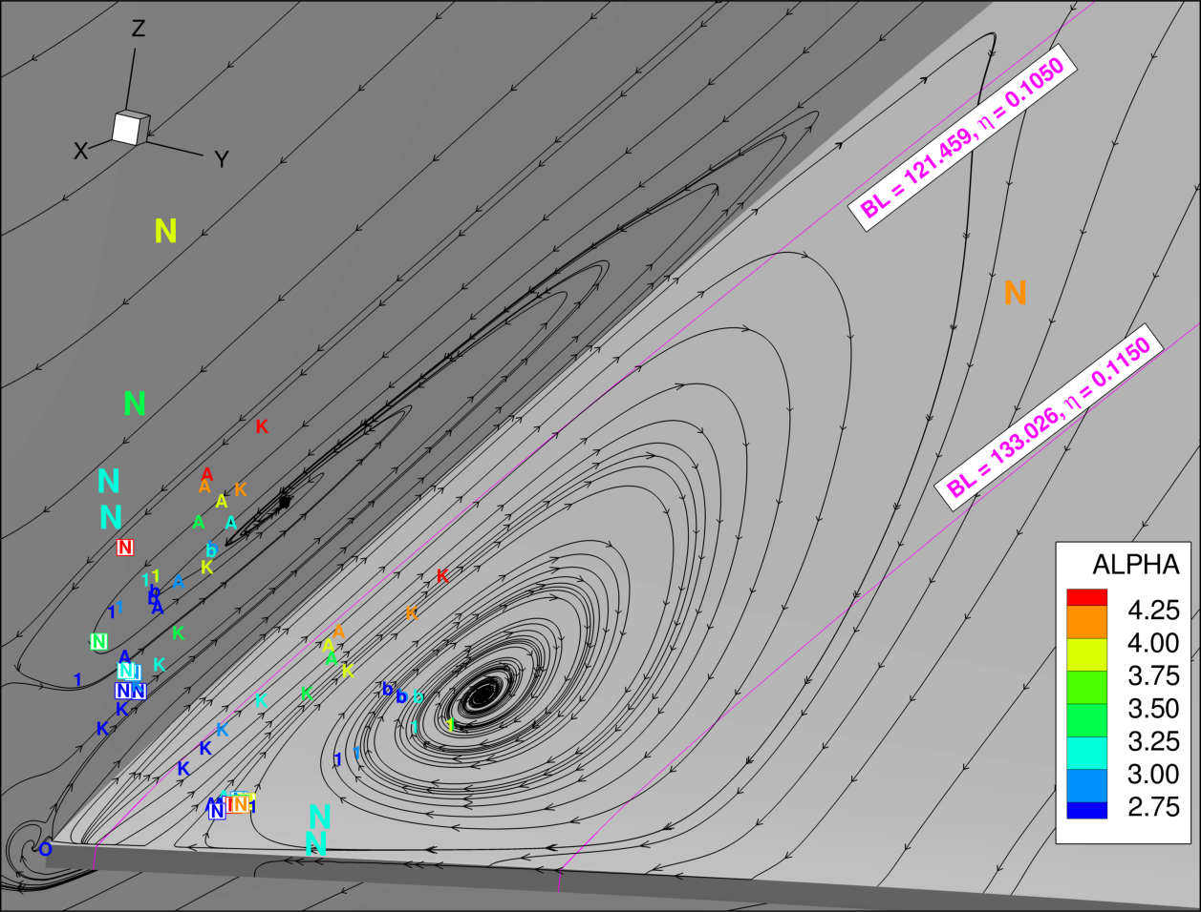
CASE 5: Alpha Sweep – Eye Locations: DDES

Slide 25
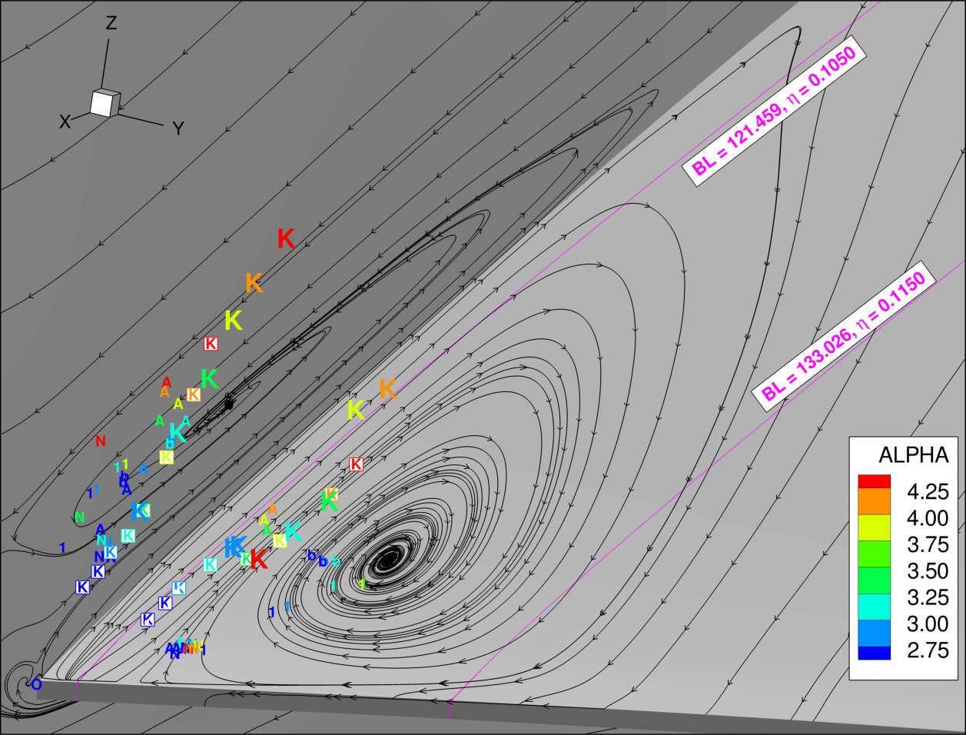
CASE 6: Alpha Sweep – Eye Locations: Aero-Structural

Slide 26
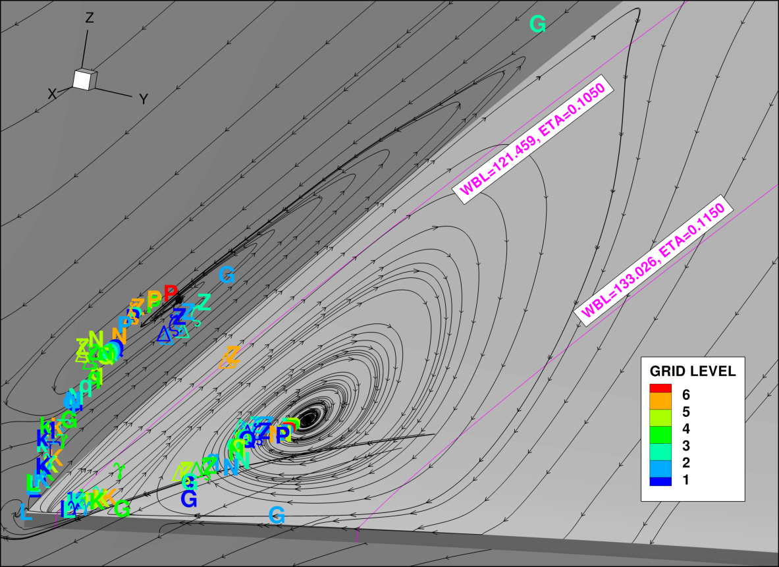
CASE 1B: Grid Refinement
DPW-7
DPW-6

Slide 27
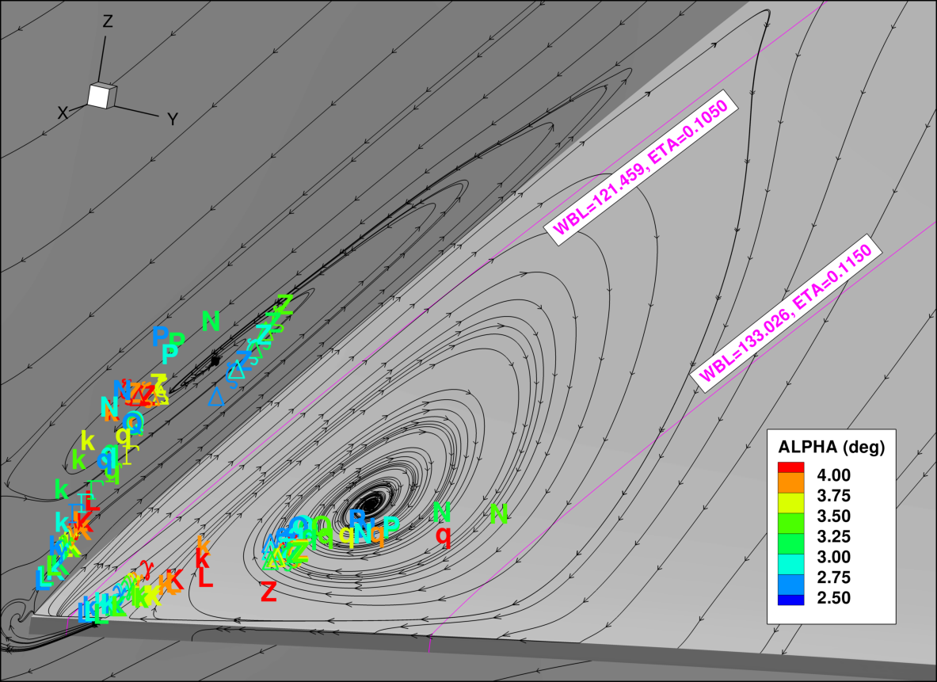
CASE 2B: Alpha Sweep
DPW-7
DPW-6

